Slide 1

Algorithms and Data Structures 2 CS 1501
Fall 2021
Sherif Khattab
ksm73@pitt.edu
(Slides are adapted from Dr. Ramirez’s and Dr. Farnan’s CS1501 slides.)

Slide 2
Announcements
Upcoming deadlines:
11/12: Lab 8 and Homework 9
11/15: Assignment 3

Slide 3
Previous lecture …
Minimum Spanning Tree
Prim’s
Priority Queue ADT
Heap implementation

Slide 4
Heap insert
Add a new node at the next available leaf
Push the new node up the tree until it is supporting the heap property

Slide 5
Min heap insert
Insert: 7, 42, 37, 5, 8, 15, 12, 9, 3
7
5
3
3
5
15
7
12
5
42
37
42
37
15
3
5
7
9
8
15
12
9
42
9
3
Notes:
Insert: 7, 42, 37, 5, 8, 15, 12, 9, 3

Slide 6
Heap remove
Tricky to delete root…
So let's simply overwrite the root with the item from the last leaf and delete the last leaf
But then the root is violating the heap property…
So we push the root down the tree until it is supporting the heap property

Slide 7
Min heap removal
3
9
42
5
7
NO!
5
9
8
7
42
8
12
9
7
8
9
42
37
15
42
9
Notes:
Remove 2x, illustrate to students you need to be careful how you swap on the way down (with the "NO!")

Slide 8
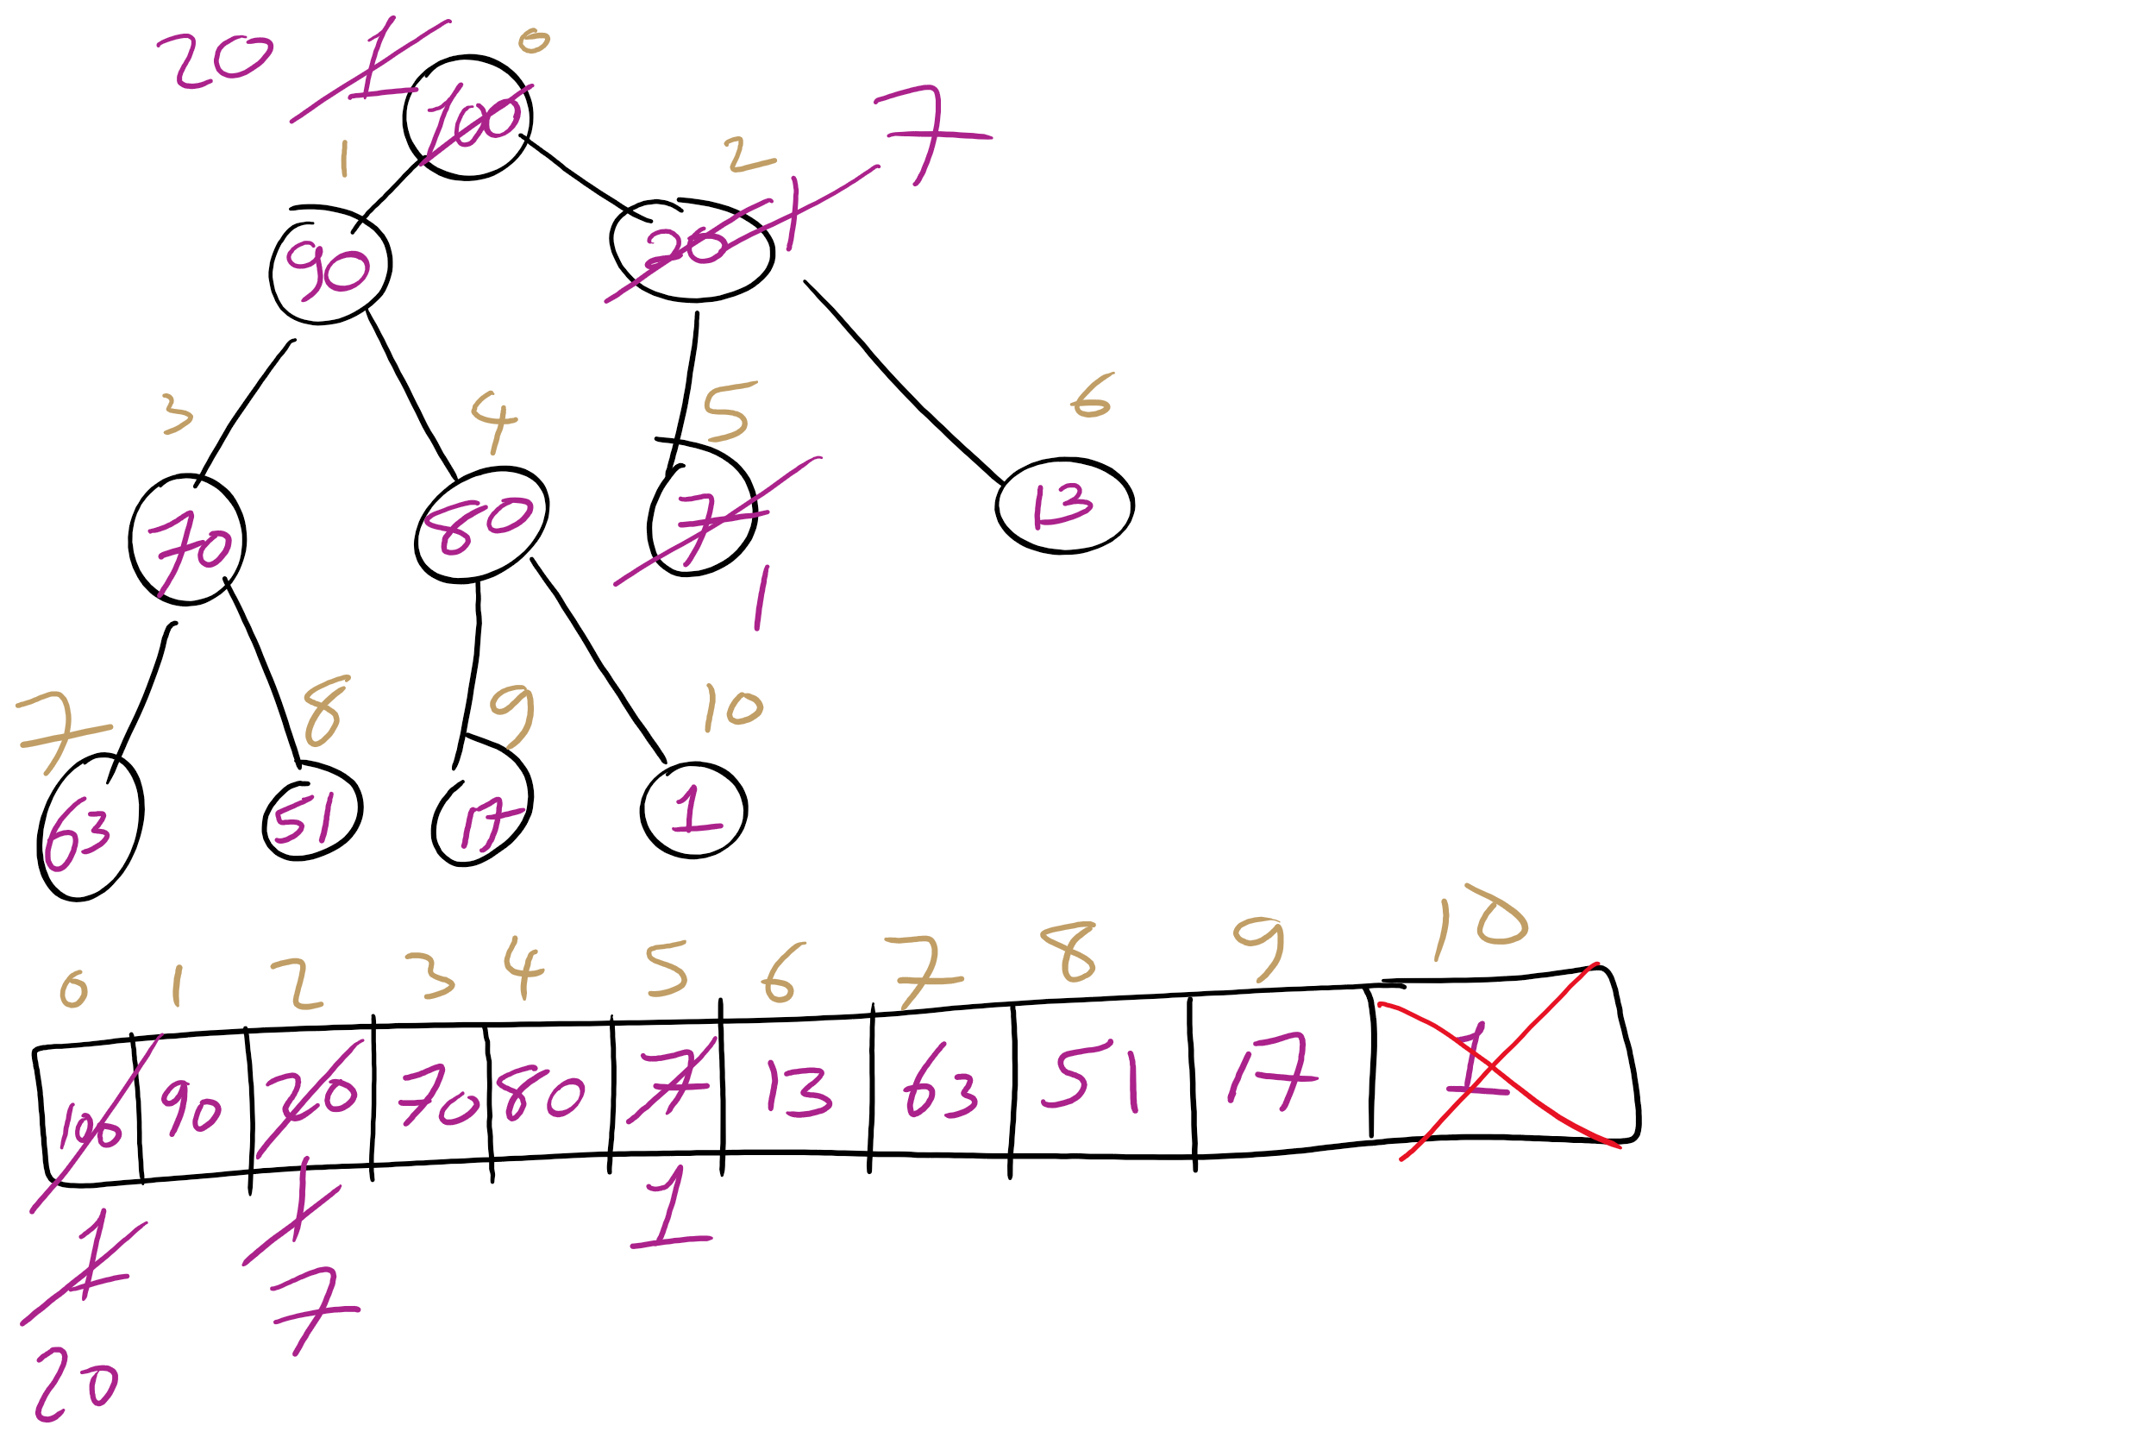
Heap RemoveMax Example

Slide 9
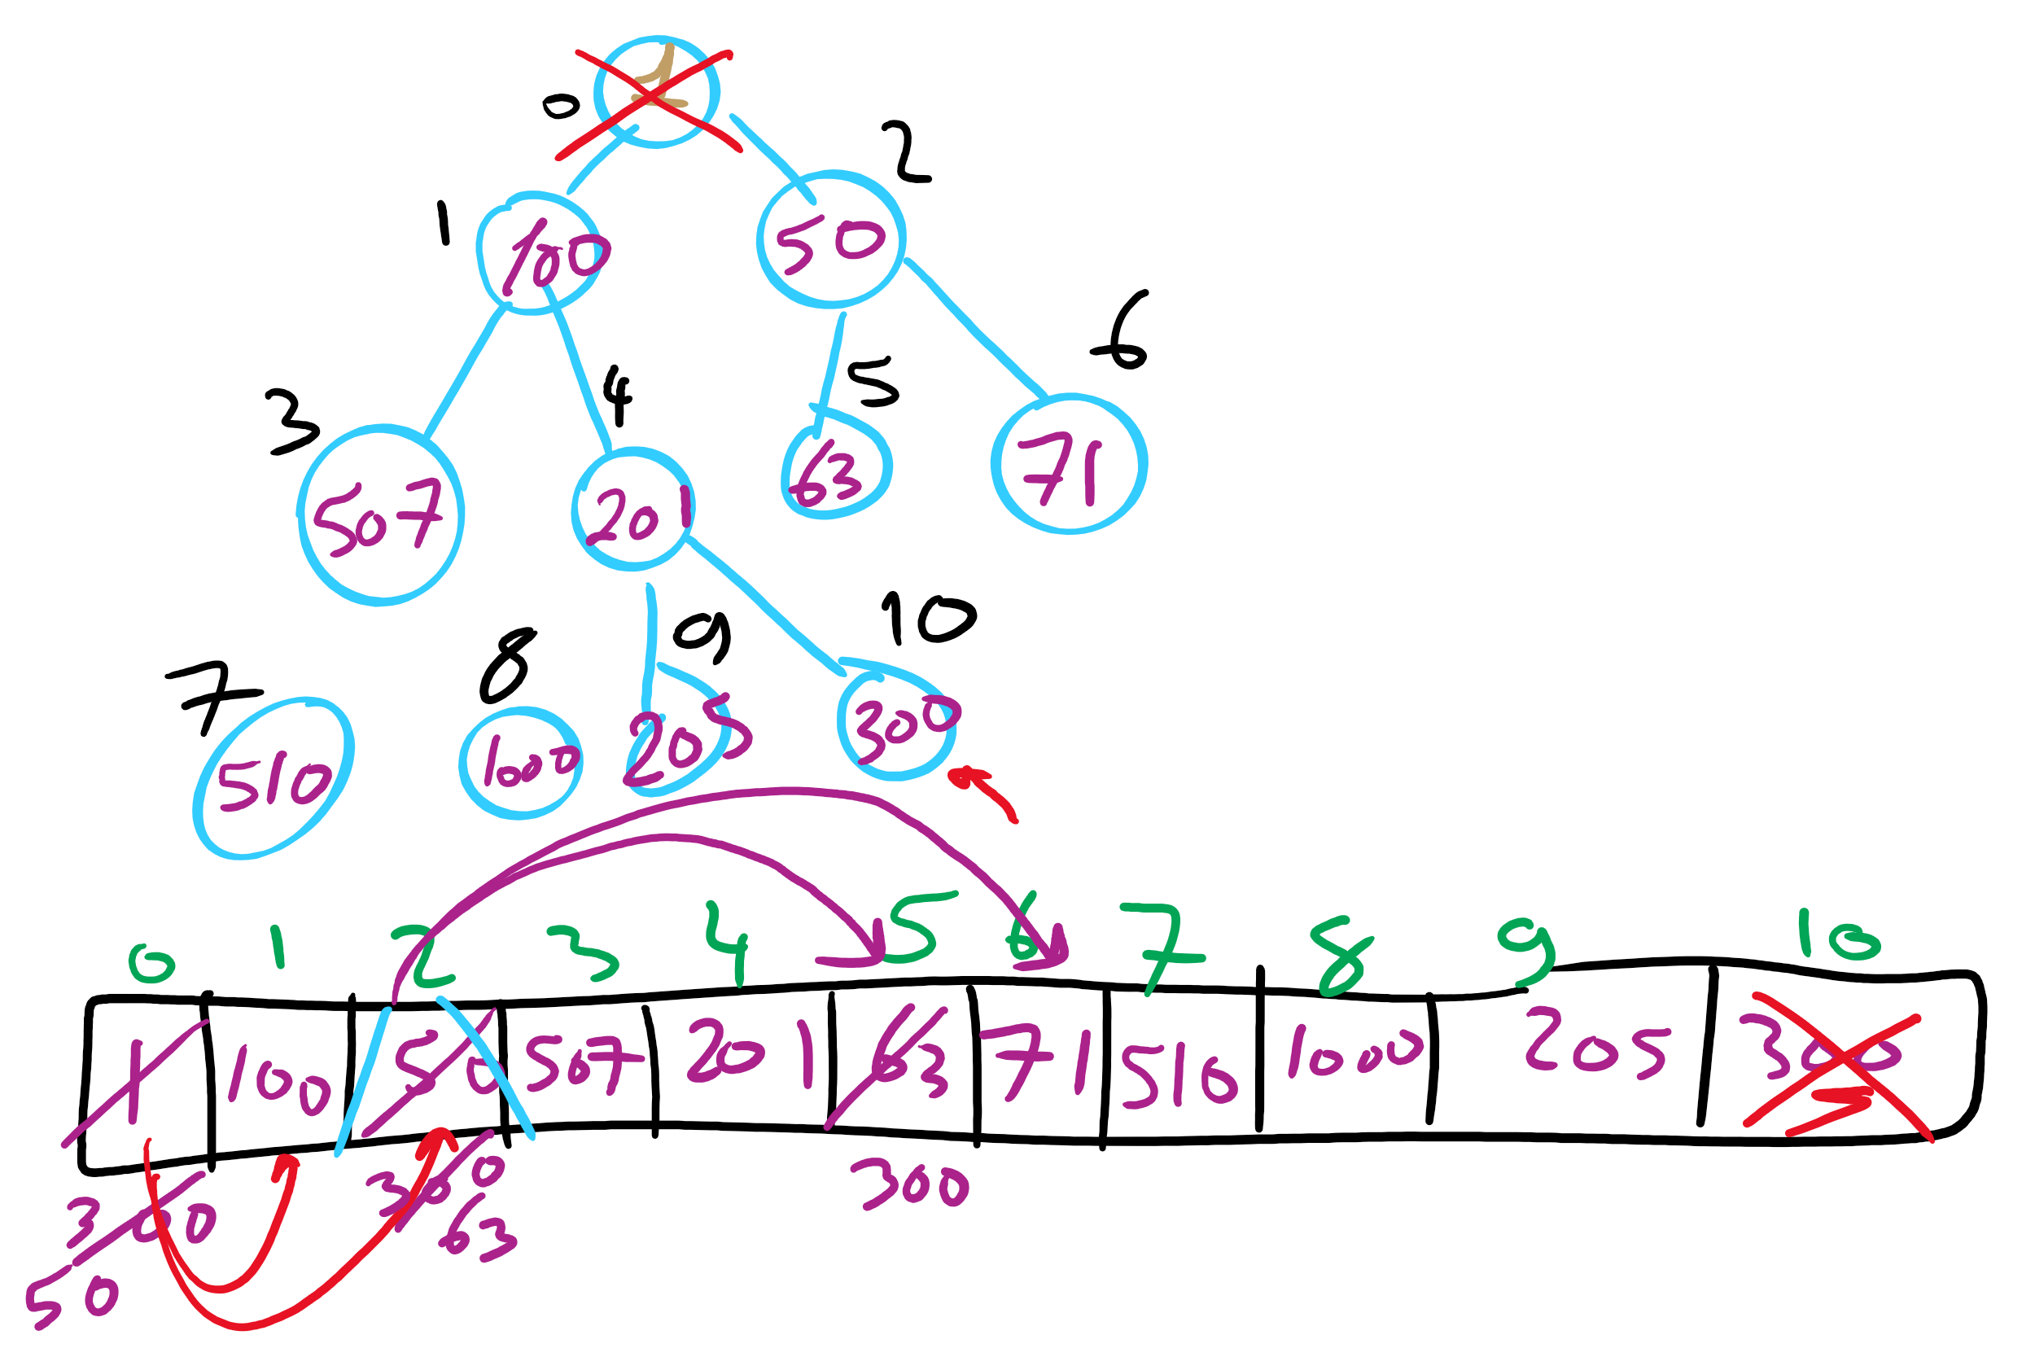
Heap RemoveMin Example

Slide 10
Heap runtimes
Find
Θ(1)
Insert and remove
Height of a complete binary tree is lg n
At most, upheap and downheap operations traverse the height of the tree
Hence, insert and remove are Θ(lg n)

Slide 11
Heap implementation
Simply implement tree nodes like for BST
This requires overhead for dynamic node allocation
Also must follow chains of parent/child relations to traverse the tree
Note that a heap will be a complete binary tree…
We can easily represent a complete binary tree using an array

Slide 12
Storing a heap in an array
Number nodes row-wise starting at 0
Use these numbers as indices in the array
Now, for node at index i
parent(i) = ⌊(i - 1) / 2⌋
left_child(i) = 2i + 1
right_child(i) = 2i + 2
For arrays indexed from 0
Notes:
Insert: 7, 42, 37, 5, 8, 15, 12, 9, 3

Slide 13
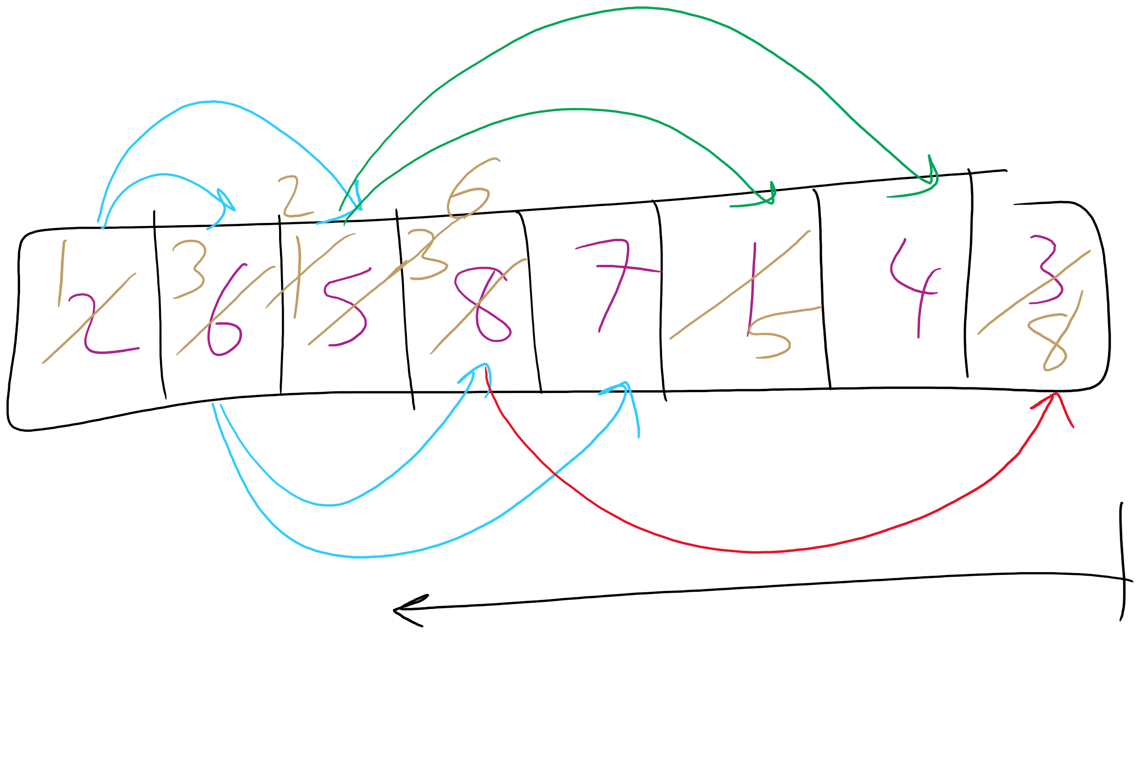
Heapify Operation

Slide 14
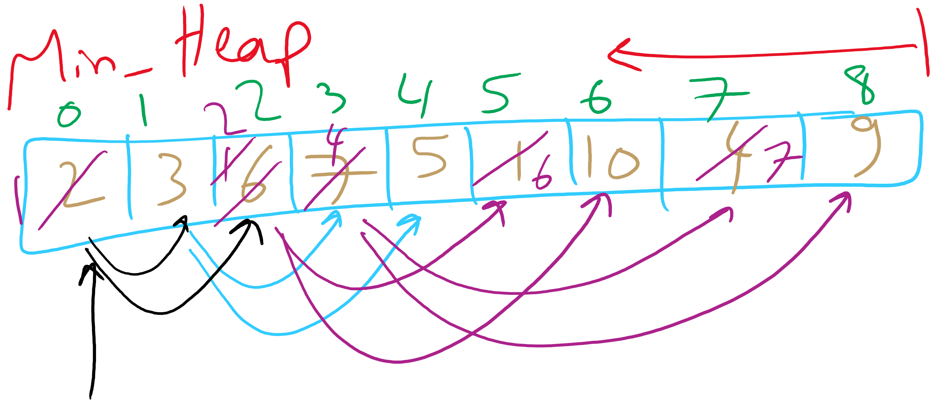
Heapify Example

Slide 15
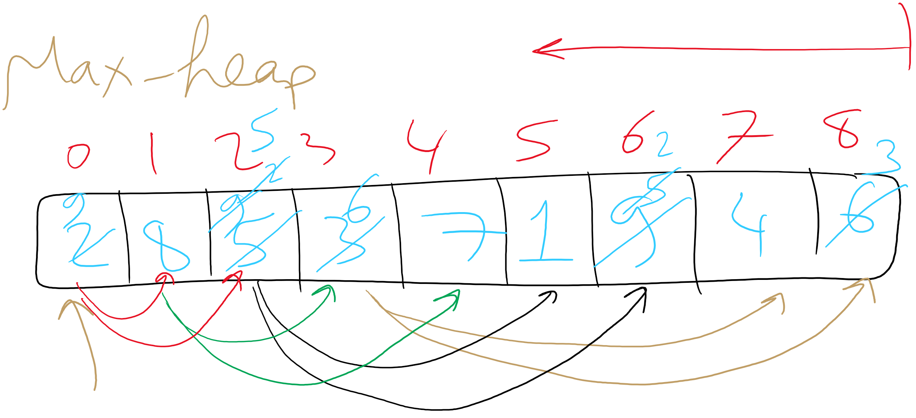
Heapify Example

Slide 16
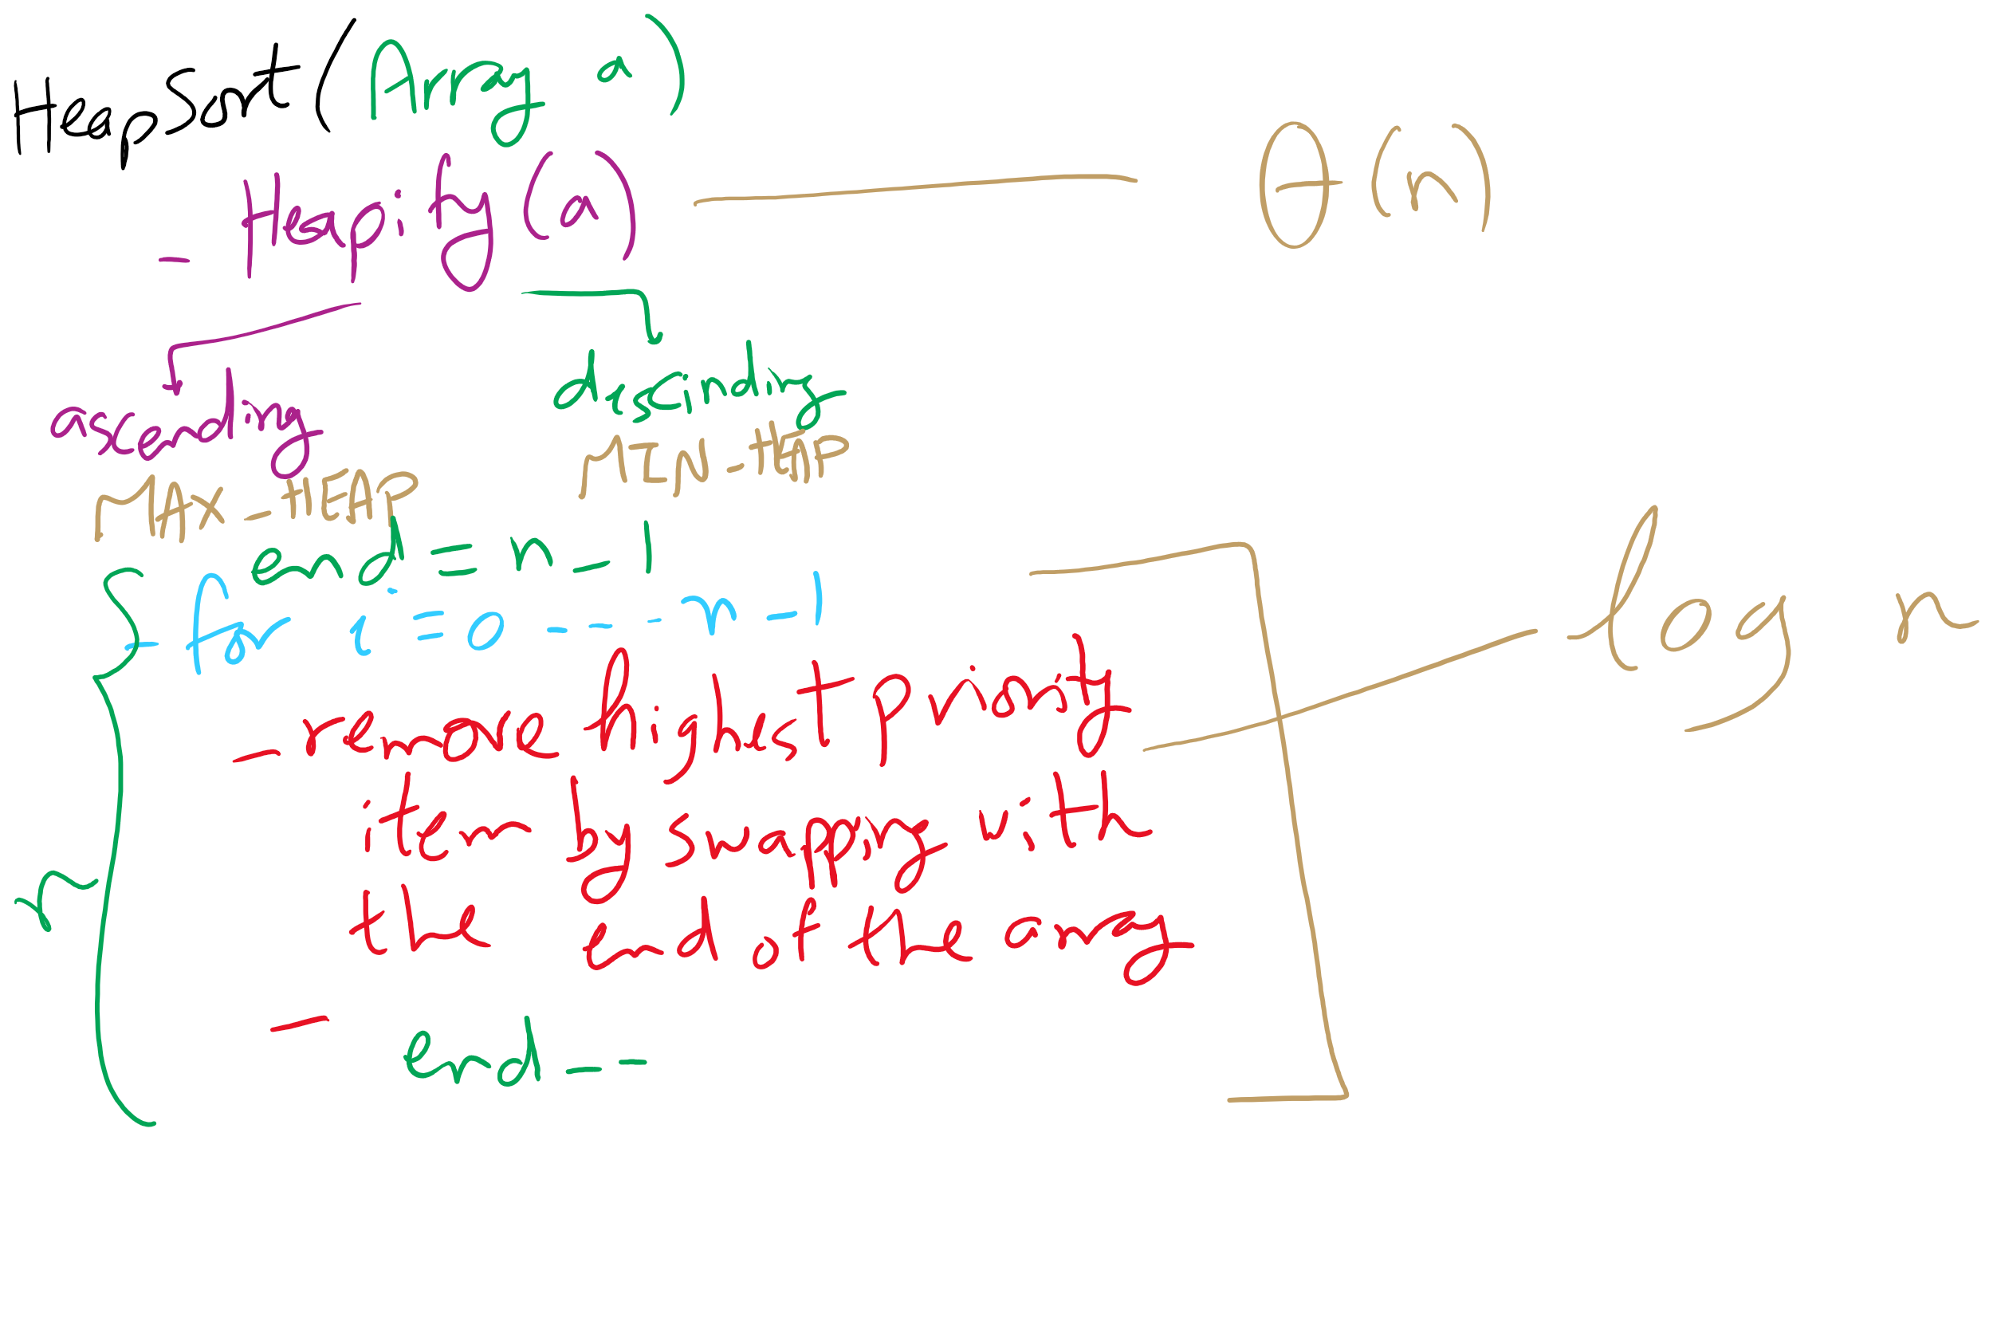
HeapSort Pseudo-code

Slide 17
Heap Sort
Heapify the numbers
MAX heap to sort ascending
MIN heap to sort descending
"Remove" the root
Don’t actually delete the leaf node
Consider the heap to be from 0 .. length - 1
Repeat
37
12
42
3
5
42
7
15
8
9
42
15
37
42
9
37
5
9
7
42
8
15
9
37
15
37
42
37
42
15
12
7
9
15
37
12
42
8
9
8
37
7
15
42
5
9
3

Slide 18
Heap sort analysis
Runtime:
Worst case:
n log n
In-place?
Yes
Stable?
No

Slide 19
Storing Objects in PQ
What if we want to update an Object?
What is the runtime to find an arbitrary item in a heap?
Θ(n)
Hence, updating an item in the heap is Θ(n)
Can we improve of this?
Back the PQ with something other than a heap?
Develop a clever workaround?

Slide 20
Indirection
Maintain a second data structure that maps item IDs to each item’s current position in the heap
This creates an indexable PQ

Slide 21
Indirection example setup
Let's say I'm shopping for a new video card and want to build a heap to help me keep track of the lowest price available from different stores.
Keep objects of the following type in the heap:
class CardPrice implements Comparable<CardPrice>{
public String store;
public double price;
public CardPrice(String s, double p) { … }
public int compareTo(CardPrice o) {
if (price < o.price) { return -1; }
else if (price > o.price) { return 1; }
else { return 0; }
}
}

Slide 22
Indirection example
n = new CardPrice("NE", 333.98);
a = new CardPrice("AMZN", 339.99);
x = new CardPrice("NCIX", 338.00);
b = new CardPrice("BB", 349.99);
Indirection
"NE":0
"NE":2
"AMZN":1
"AMZN":0
"AMZN":1
Update price for NE: 340.00
"NCIX":0
"NCIX":2
"NCIX":3
"NCIX":1
"BB":0
"BB":3
"BB":1
Update price for NCIX: 345.00
Update price for BB: 200.00
a
b
b
x
n
a
x
x
a
x
n
b
Notes:
How are our runtimes affected?
space utilization?
how should we implement the indirection?
what are the tradeoffs?

Slide 23
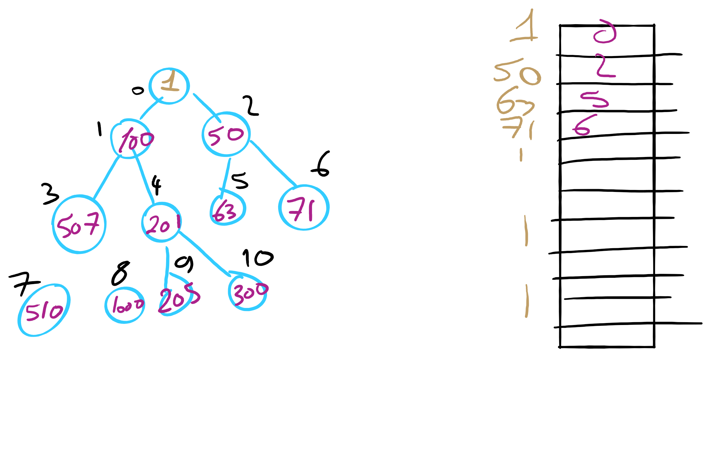
Indexable PQ Example

Slide 24
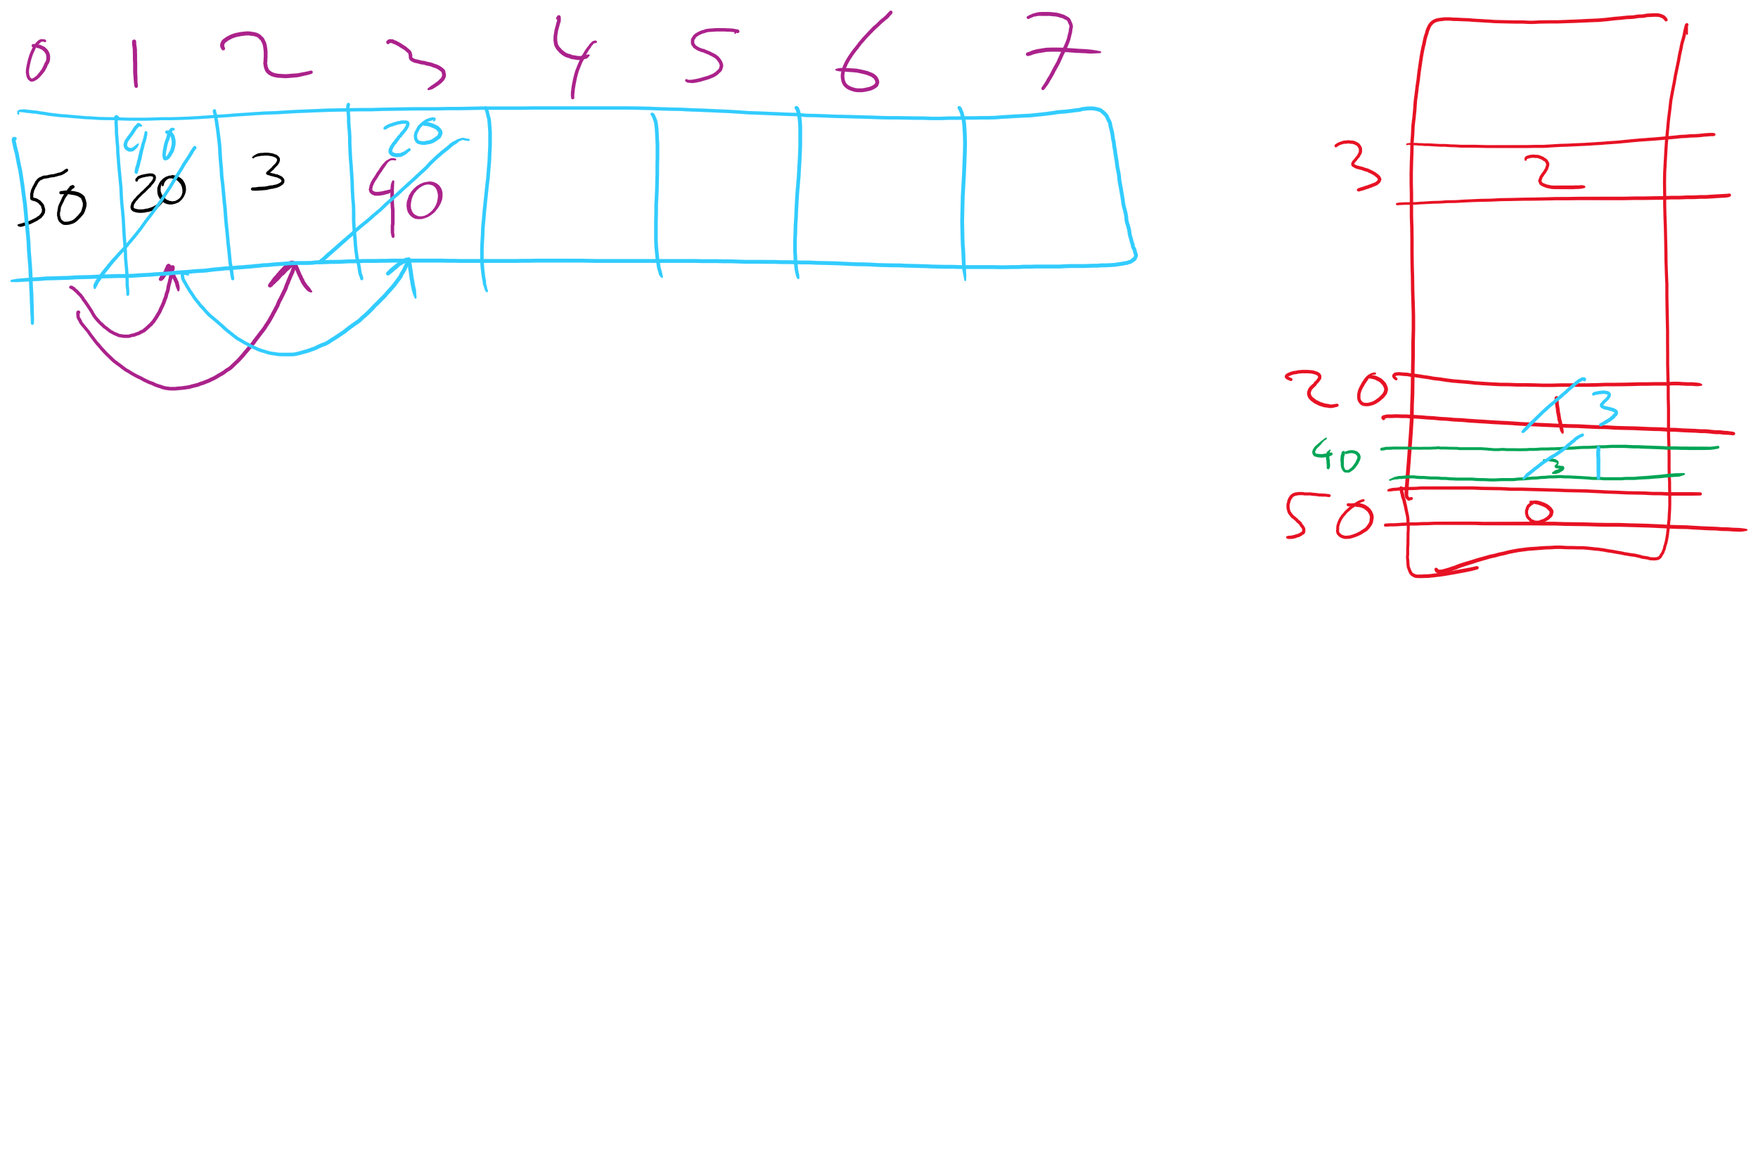
Indexable PQ Example

Slide 25
Prim’s MST: What about a faster way to pick the best edge?
Sounds like a job for a priority queue!
Priority queues can remove the min value stored in them in Θ(lg n)
Also Θ(lg n) to add to the priority queue
What does our algorithm look like now?
Visit a vertex
Add edges coming out of it to a PQ
While there are unvisited vertices, pop from the PQ for the next vertex to visit and repeat
Notes:
Change in runtime?
θ(d) work to list neighbors,
in the worst case, v == d, so no asymptotic improvement, but a practical one.
Less memory required to store the graph
but doesn't affect memory required to run the algorithm, still need 2 * θ (v) to store parent and best edge arrays
this version of Prim's just adds all edges to a PQ
before we constrained ourselves to only maintain v best edges to look at
how do we get the best of both?
indexable pq

Slide 26
Prim's with a priority queue
0
0
PQ:
6
5
1
1
3
1: (0, 2)
1
3
2: (5, 3)
5
5
3: (1, 4)
2
2
3
2
4: (2, 5)
6
4
5: (2, 3)
5: (0, 3)
4
5
4
5
6
5: (2, 1)
6: (0, 1)
6: (2, 4)
6: (5, 4)

Slide 27
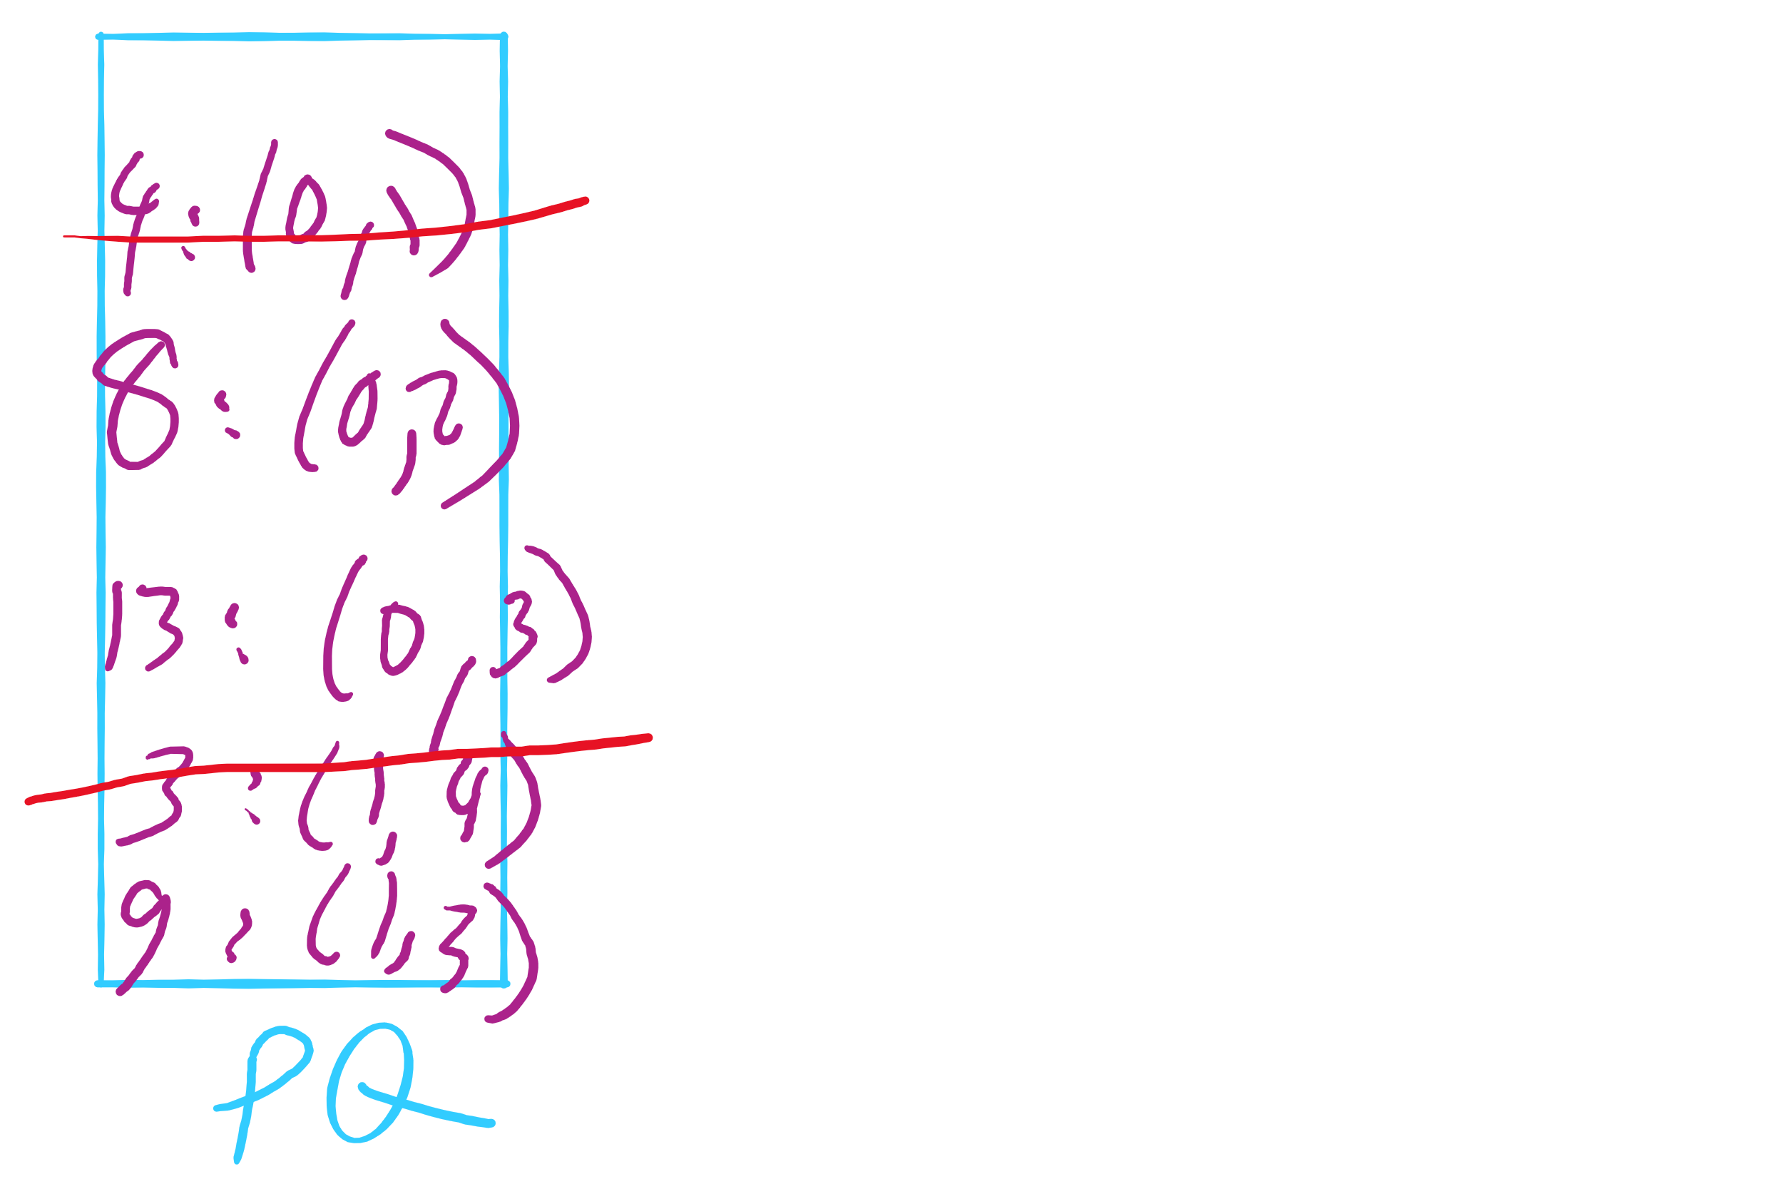
Lazy Prim’s Partial Example

Slide 28
Runtime using a priority queue
Have to insert all e edges into the priority queue
In the worst case, we’ll also have to remove all e edges
So we have:
e * Θ(lg e) + e * Θ(lg e)
= Θ(2 * e lg e)
= Θ(e lg e)
This algorithm is known as lazy Prim’s
Notes:
discuss why this isn't lg v for PQ operations, lead to how we constrained number of best edges before to be v, lead to indexable PQ discussion

Slide 29
Do we really need to maintain e items in the PQ?
I suppose we could not be so lazy
Just like with the adjacency matrix implementation, we only need the best edge for each vertex
PQ will need to be indexable
This is the idea of eager Prim’s
Runtime is Θ(e lg v)

Slide 30
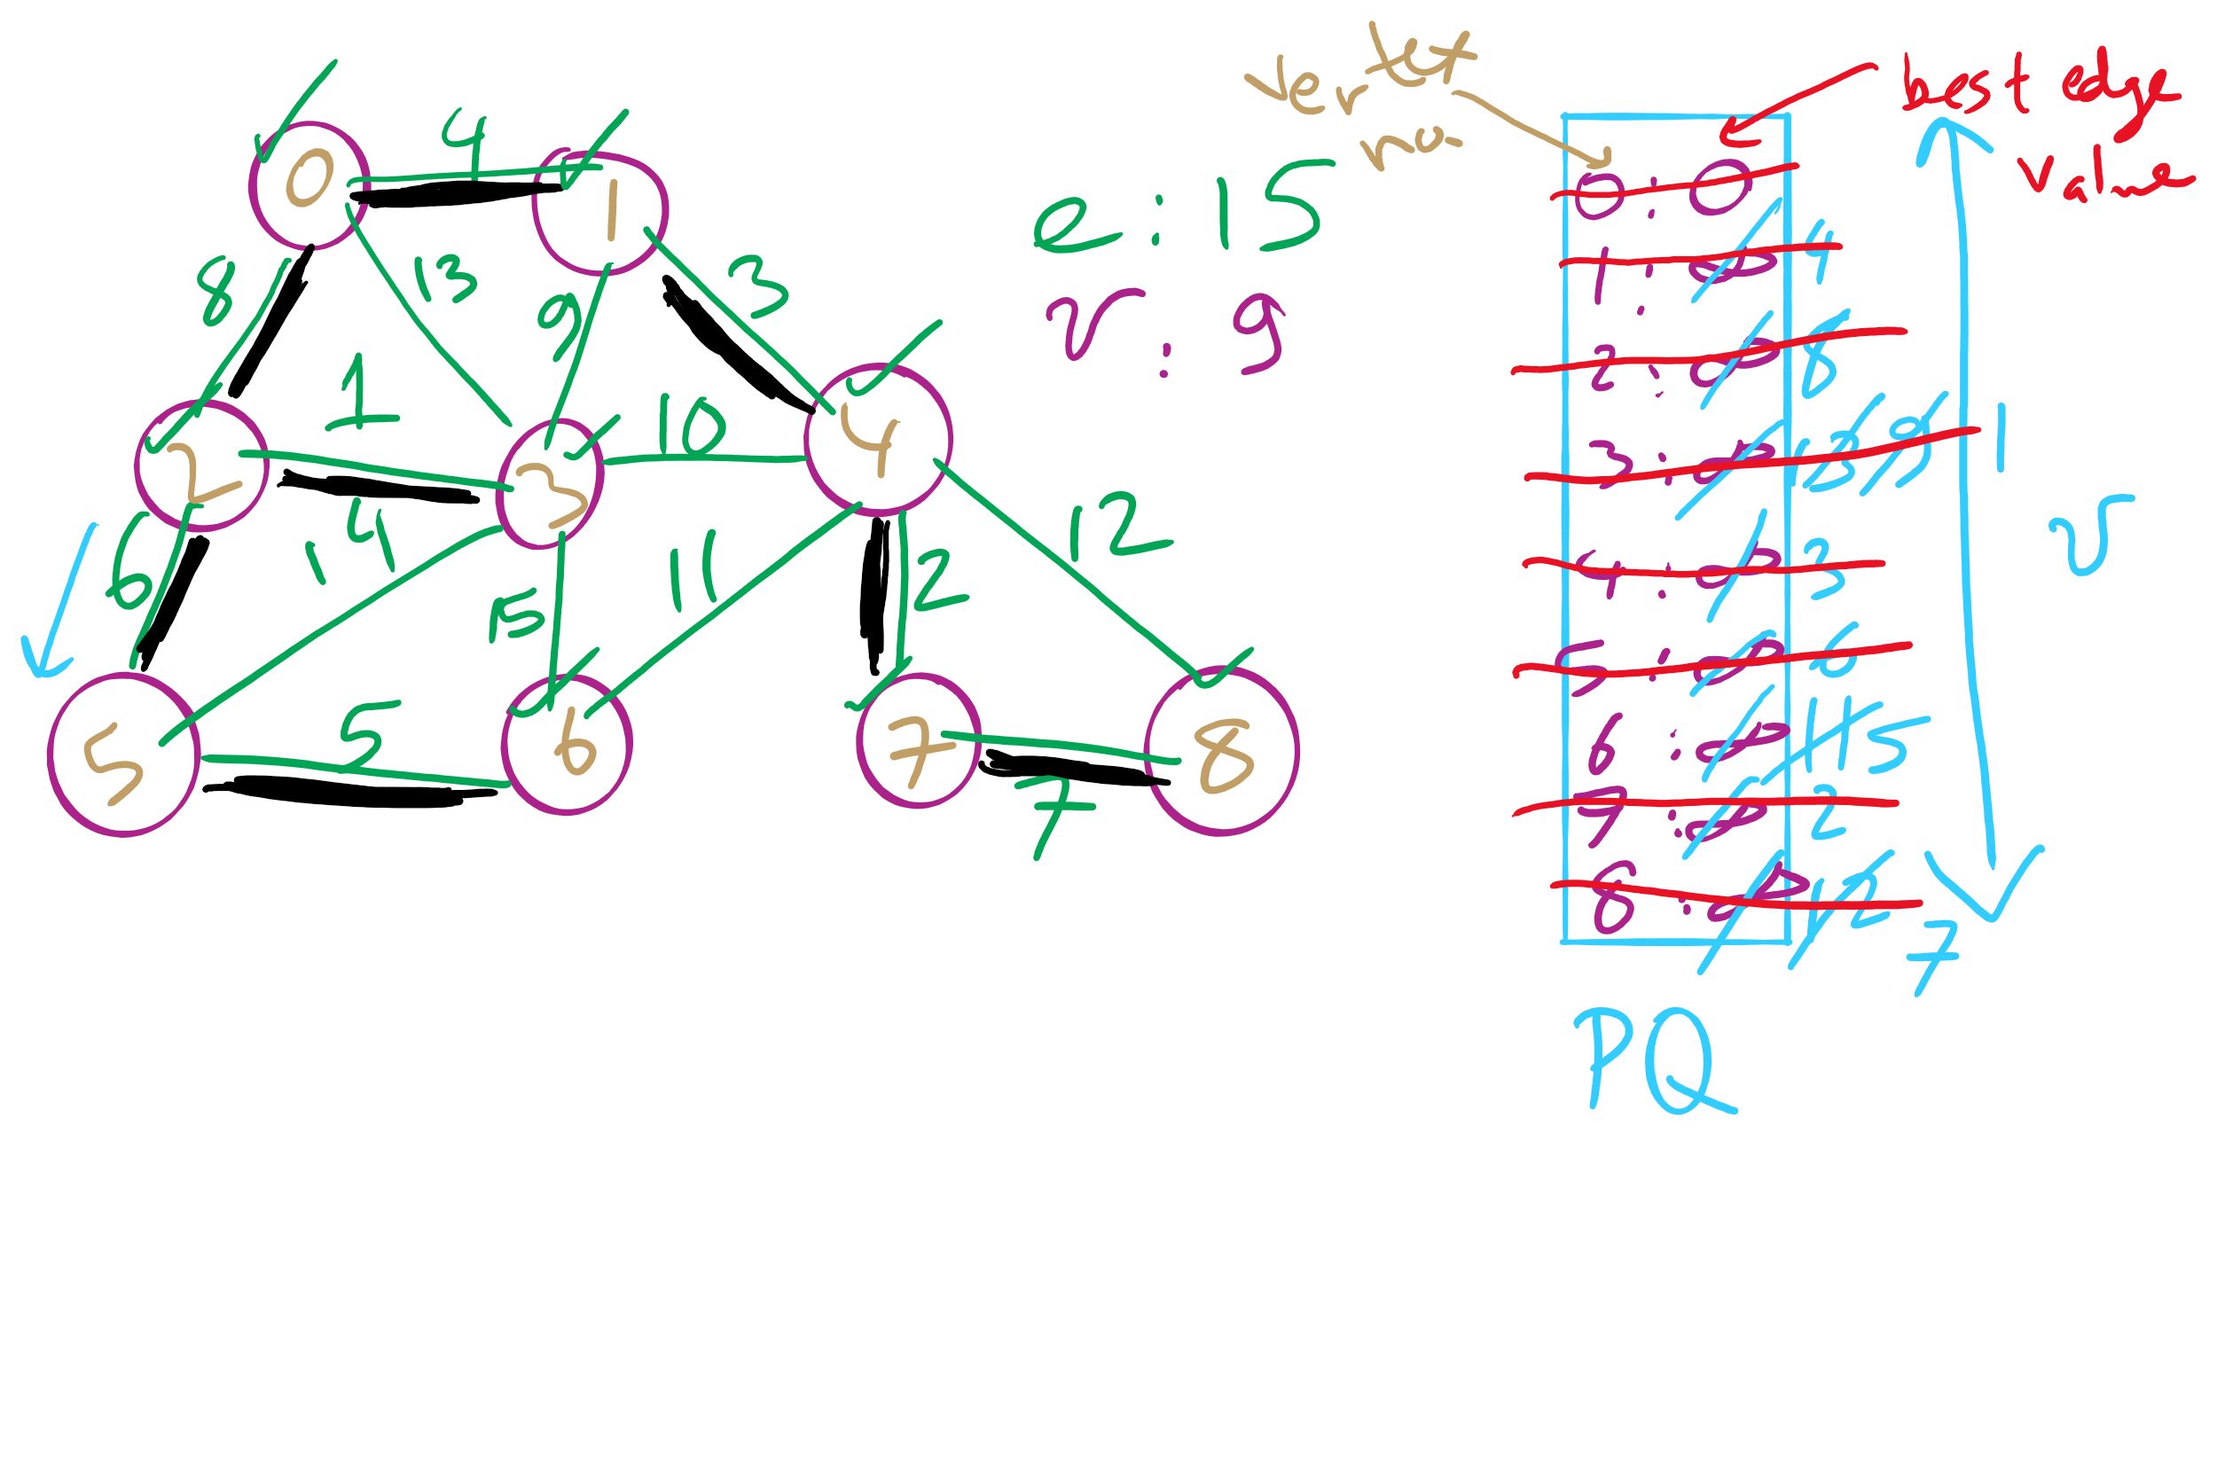
Eager Prim’s Example 1

Slide 31
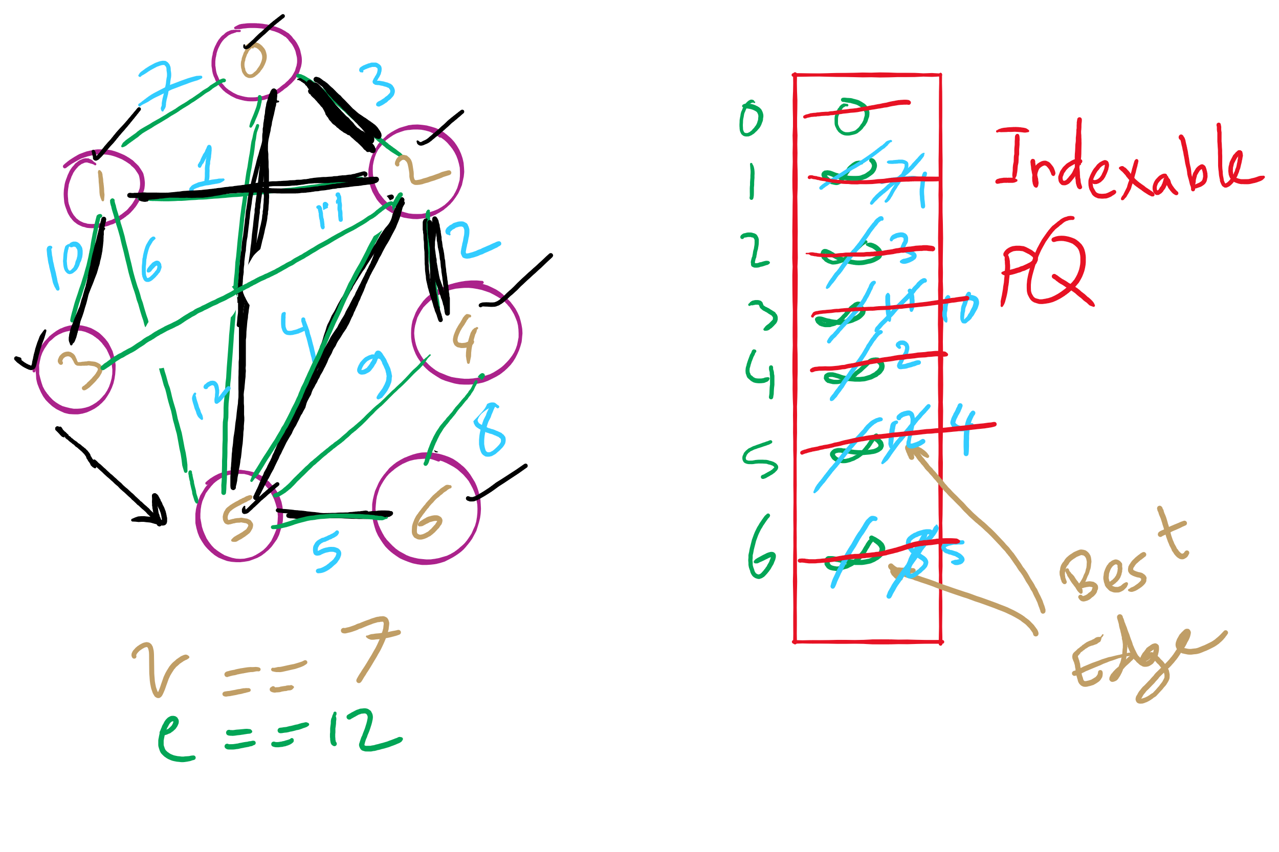
Eager Prim’s Example 2

Slide 32
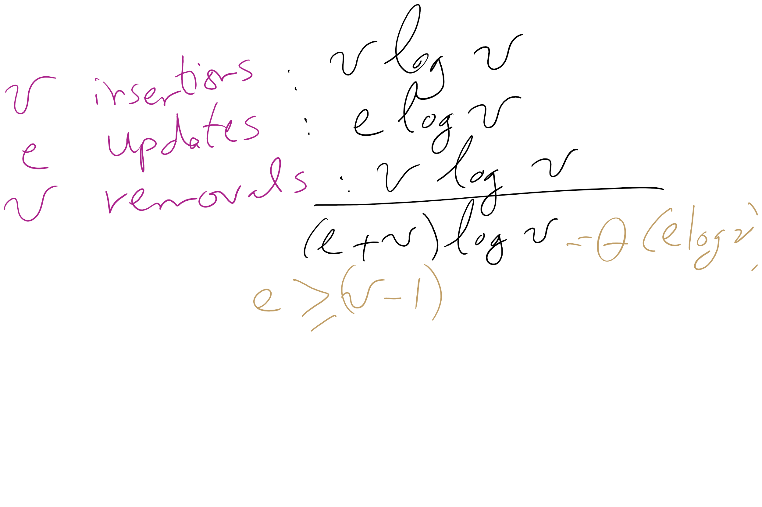
Eager Prim’s Runtime

Slide 33
Please submit your reflections by using the CourseMIRROR App
If you are having a problem with CourseMIRROR, please send an email to coursemirror.development@gmail.com
Notes:
All right!
Upcoming Due Dates at A Glance

